Slide 1


Inventory and Barcode System Client: Lettuce Dream by Graduate Directed Project -2 Northwest Missouri State University

Slide 2
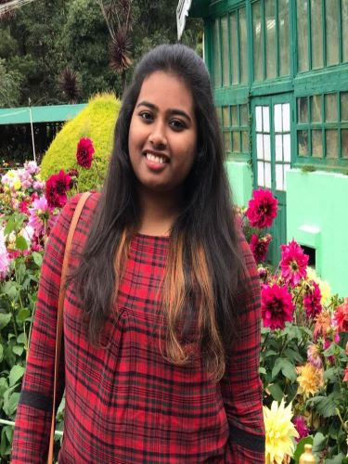
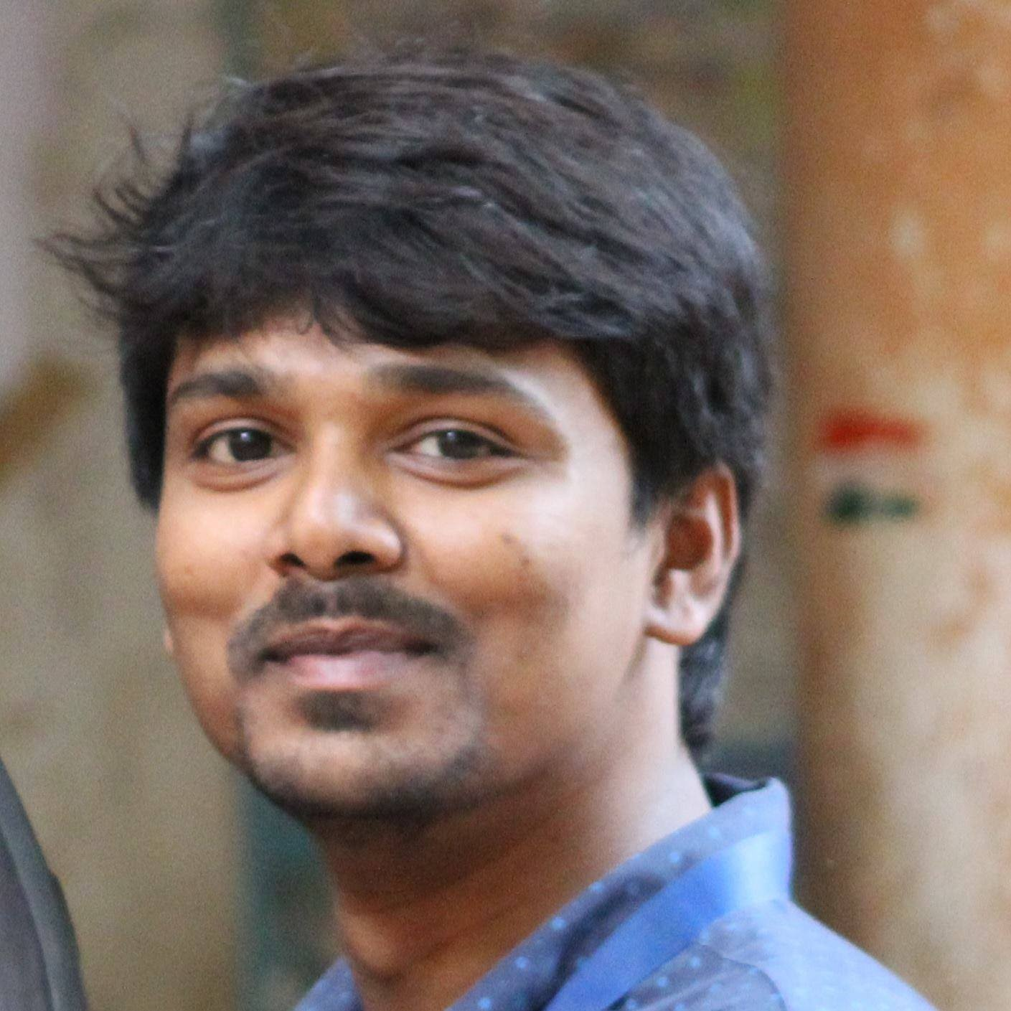
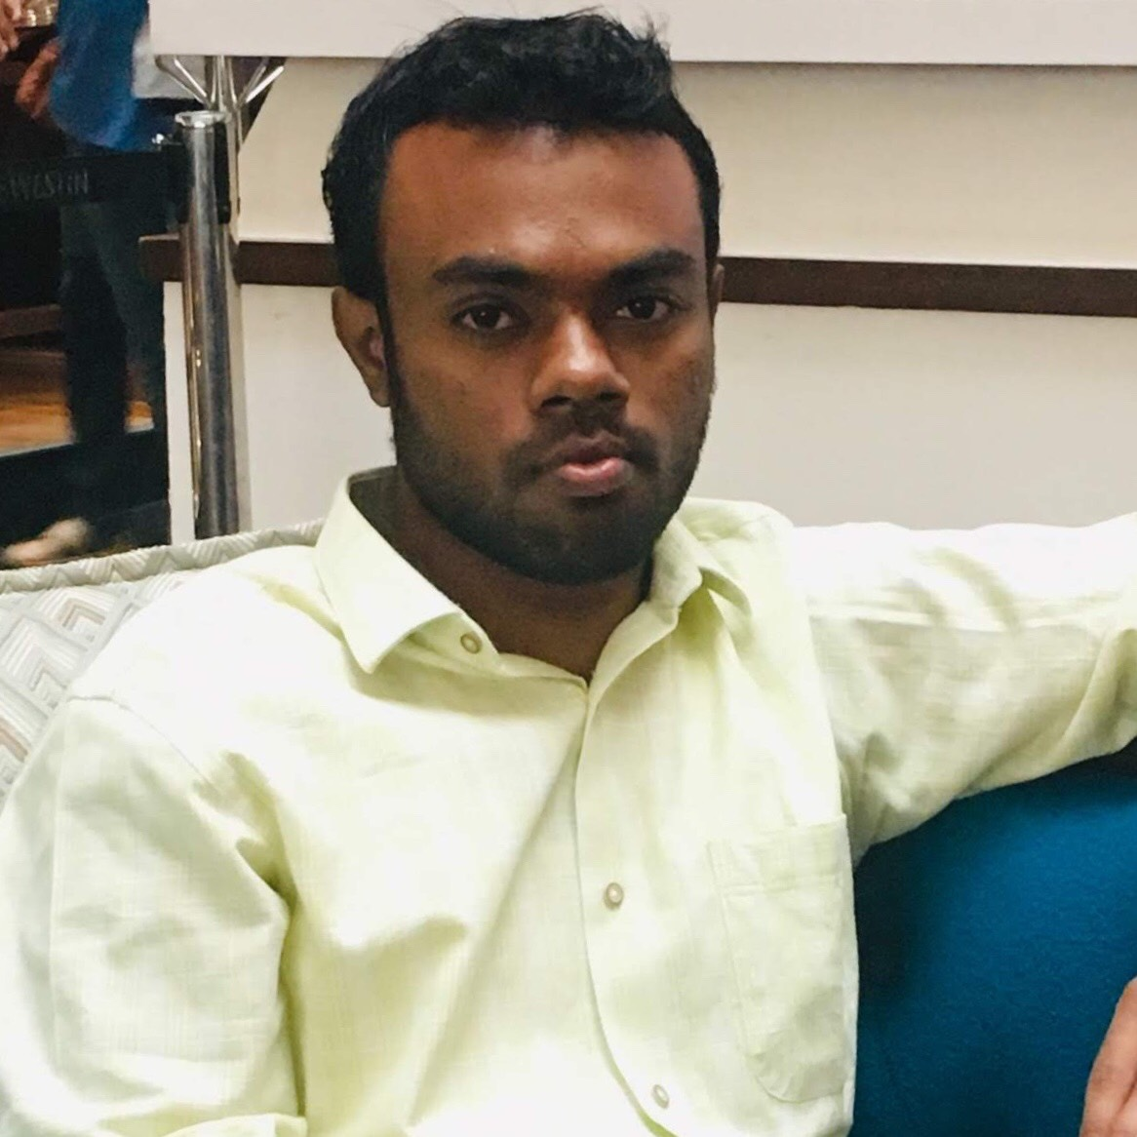
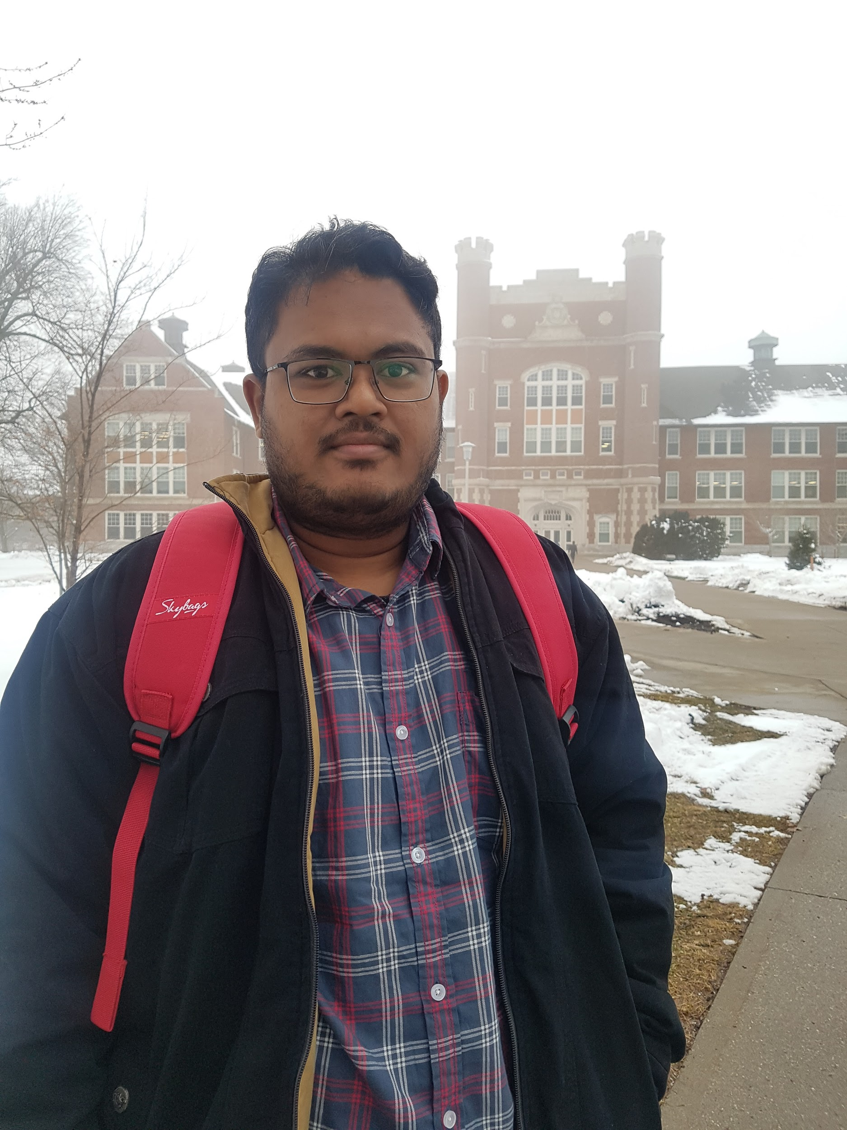
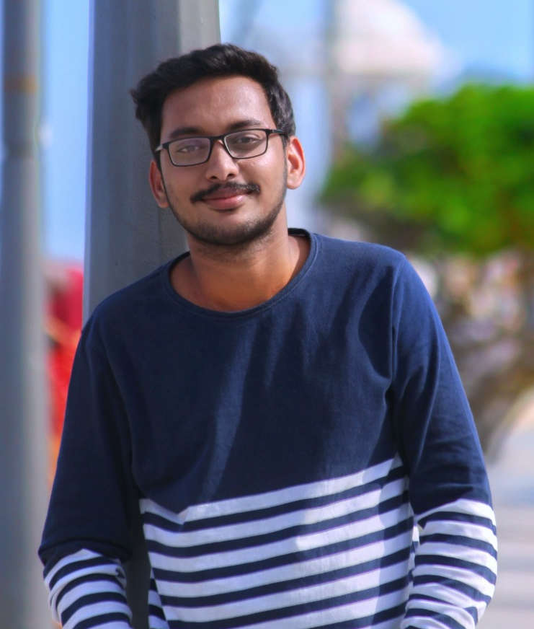

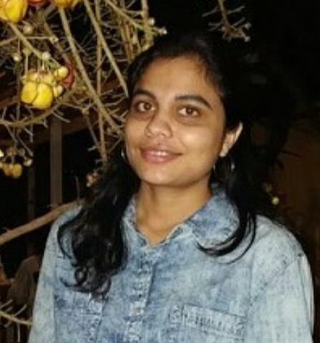
Back End
Team
Sanjana Baswapuram
Sandeep KV
Rajesh Kammari
Prajakt Uttamrao Khawase
Front End
Team
Ravi Varma
Chatur Veda Vyas
Sai Sri Dachepalli

Slide 3
Contents
Accomplishments since midterm
Artifacts
Application demonstration
Issues encountered
Technologies and tools
Lessons learned
Conclusion
Sanjana Baswapuram

Slide 4
Accomplishments since midterm
Bay
Package type
Product catalog
Customer
Barcode generation
Navigation bar
Add details
Generating barcode and reports
Sanjana Baswapuram
Notes:
Add Product
Add customer
Add package
Add bay
Production Reports

Slide 5
Use cases:
Bar code generation
Unique bar code generation
Label along with bar code
Navigation bar
Sandeep KV

Slide 6
Use cases: contd..
Scans
Inventory status reports
Customer tracking reports
Adding products or customer to database
Sandeep KV

Slide 7
Database
Database designed with nine entities with Barcode as unique key
In house database is being used to save the costs of cloud
Database is common to both the Inventory and Human management teams
Security is being maintained to keep the sensitive data confidential
Aids in generating the important reports
Rajesh

Slide 8
Application demonstration
Ravi Varma Devulapally

Slide 9
Issues resolved
User interface complexity
Not using the right versions
Insertion of icons
Difficult to reuse
The web page rendering algorithm of React framework is time-consuming
Merging individual layouts as dependency issue occurs
Chatur

Slide 10
Technologies and tools
Adobe XD
HTML, CSS and JavaScript
React JS
Java
Spring framework
MySQL
Tomcat
Sai Sri Dachepalli

Slide 11
Significant accomplishments
Accurately understanding client requirements
Generating prototypes
Usability testing
Designing navigation bar
Application development
Sai Sri Dachepalli

Slide 12
Future work: “where to start?”
Understand client’s requirement
Visiting client’s location
Tools and technologies
Analyzing future requirements (technologies)
Refer documentation
Collaborate frontend and backend APIs
Sai Sri Dachepalli

Slide 13
Lessons learned
Communication skills
Co-ordination within team
Gathering requirements from the novice users.
Managing and scheduling the tasks
Efficient use of tools and software
Project designing and future planning
Prajakt

Slide 14
Conclusion
Developed global and user friendly application
Most of the functionality is completed and working
Testing and maintenance
Client can request for new functionality
Prajakt

Slide 15
Thank you…!!!

Slide 16
Questions… ?

Slide 17
References
http://www.lettucedream.org
https://barcode.tec-it.com/en/Code128?data=LD190411D01BR

